Slide 1

Package Pricing prediction at mission hospitals

Slide 2

Building a Stronger Healthcare Network at Mission Hospital
Mission Hospital is a super-speciality corporate hospital in Durgapur.
Handles high patient volumes, especially cardiac and critical-care
Serves international patients from Bhutan, Sri Lanka, and beyond
State-of-the-art infrastructure and NABH accreditation
Strong tie-ups with government schemes and public insurance programs.
Committed to affordable, high-quality, data-driven care

Slide 3

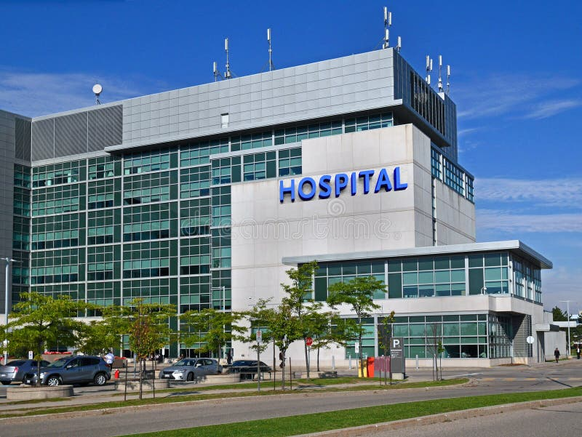




Slide 4


Flat Pricing Vs Package Pricing
Flat Pricing
Package Pricing
Each item / procedure/ medication is billed separately
Total cost varies by Patient
Financial risk is on Patient
Suitable for hospitals when cost is unpredictable
Best for Complex cases
Patients cannot estimate the bill
Not competitive with other hospitals
A fixed cost quoted before admission
Covers consultation, ICU, surgery, ward stay, medication, implants cost etc.
Financial risk is on hospital
Attractive to Patients
Suitable for low clinical complication rate cases
Bill is transparent to patients
Hospital should do statistical cost analysis to avoid financial risk

Slide 5
Dataset overview
Demographics: Age, Gender, Weight, Height
Clinical Vitals: Blood Pressure (BP), Pulse, Respiratory Rate (RR), Hemoglobin rate (HB)
Resource Utilization: ICU stay, Ward stay, Total Length of Stay
Procedure Indicators: Implant usage & cost
Comorbidities: Diabetes, Hypertension
Primary Complaint: KEY_COMPLAINTS_CODE
Target Variable: Total cost to hospital

Slide 6
Key Complaint code
Codes given to the key complaints faced by the patient:
Adult Congenital Heart Disease (ACHD)
Coronary Artery Disease – Double Vessel Disease (CAD-DVD)
Coronary Artery Disease – Single Vessel Disease (CAD-SVD)
Coronary Artery Disease – Triple Vessel Disease (CAD-TVD)
Coronary Artery Disease with Ventricular Septal Defect (CAD-VSD)
Ostium Secundum Atrial Septal Defect (OS-ASD)
Other Non-Specific Cardiac Complaints (other- heart)
Other Respiratory System Complaints (other- respiratory)
Non-Cardiac General Medical Complaints (other-general)
Neurological or Nervous System Complaints (other-nervous)
Tetralogy of Fallot (TOF) or Other Tetralogy-Type Defects (other-tetralogy)
Post–Myocardial Ventricular Septal Defect (PM-VSD)
Rheumatic Heart Disease (RHD)

Slide 7
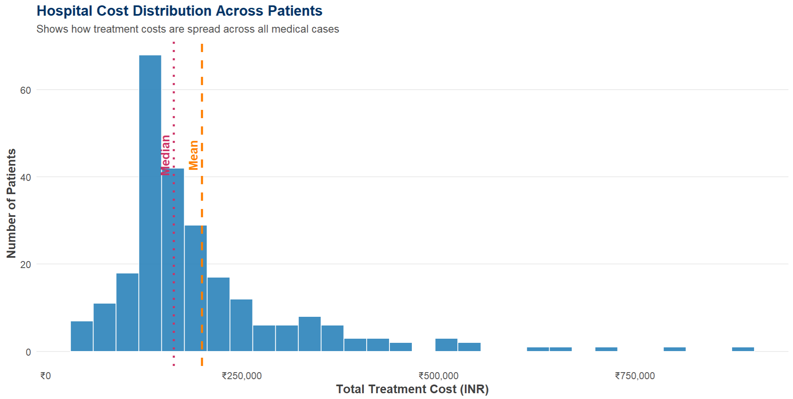
Treatment Cost Distribution and Central Tendency Insights

Slide 8
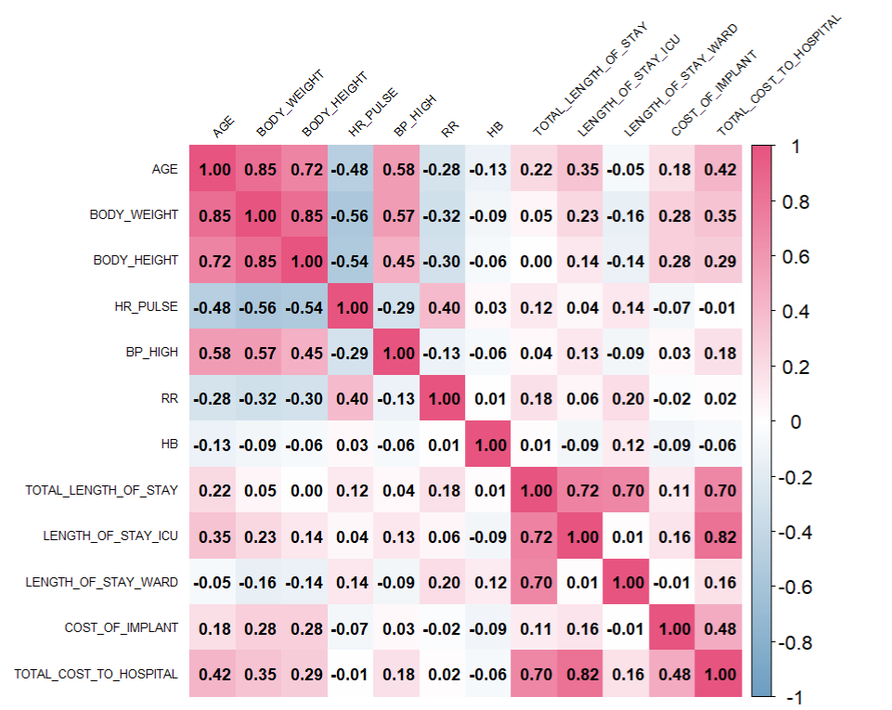
Clinical Drivers of Hospital Cost: Correlation Analysis

Slide 9
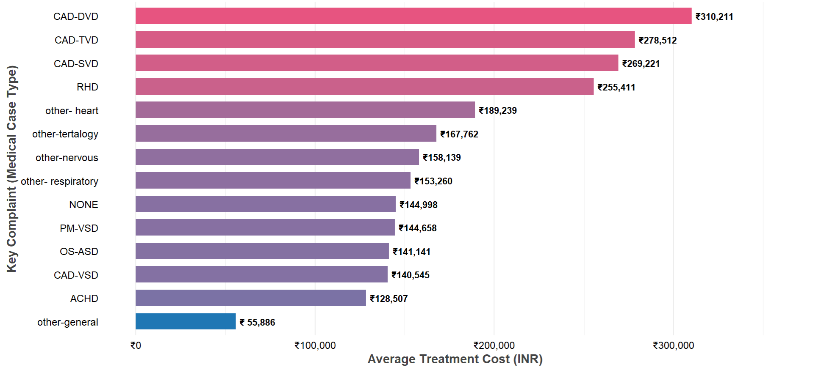
Average Hospital Cost Across Key Complaints

Slide 10
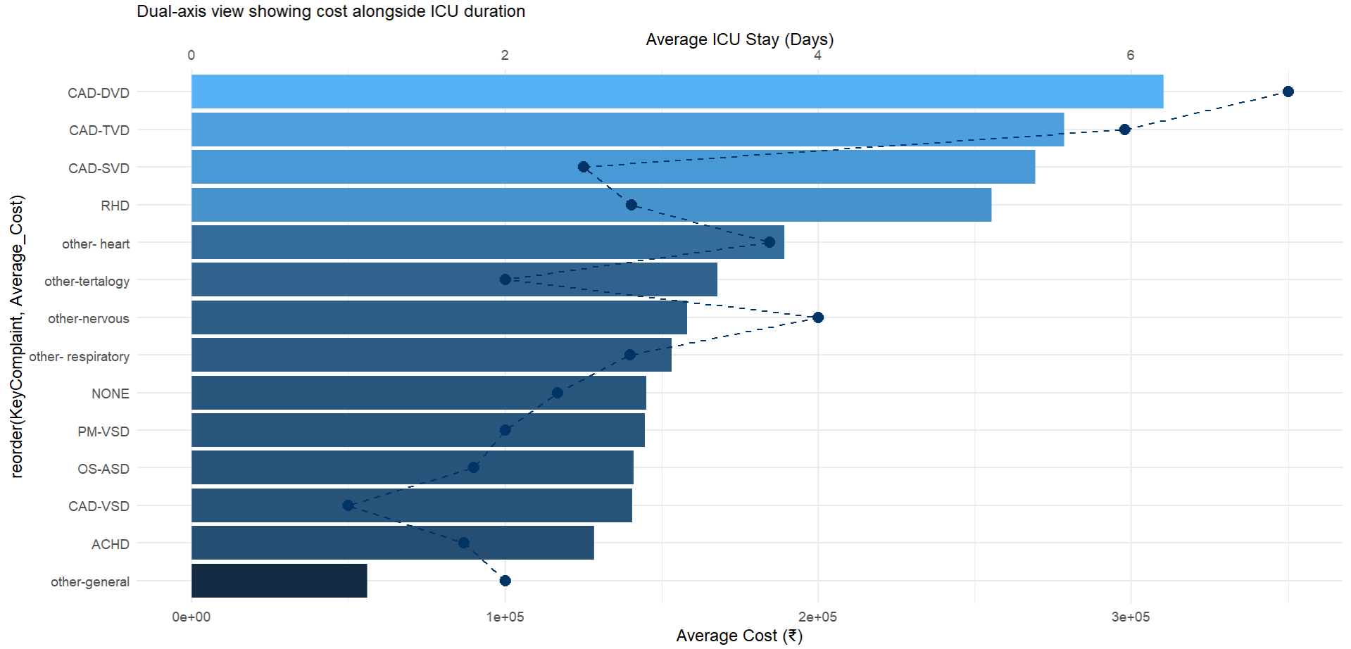
Treatment Cost and ICU Days: Dual-Axis View

Slide 11

When Should Hospitals Use Package Pricing?

Slide 12

Package pricing is ideal when:
Treatment pathway is standardized
Cost variation is low
ICU stay and implant usage are predictable
Clinical complication rate is low
High sample volume (historical data) exists to make prediction
Predictability of ML model (R²) should be high, indicates cost can be predicted accurately using patient and clinical data
High R² indicates stable and consistent cost pattern
Low R² indicates not safe for package pricing

Slide 13
Complaint - Wise Cost Predictability Analysis Using Linear Regression
Complaint | Count | RMSE (₹) | MAE (₹) | R²
RHD | 26 | 40,383.10 | 30,203.93 | 0.9970
other-heart | 55 | 61,685.09 | 50,528.97 | 0.8814
CAD-TVD | 24 | 194,031.56 | 133,493.52 | 0.7816
CAD-DVD | 27 | 171,181.03 | 163,054.27 | 0.6825
NONE | 36 | 21,681.99 | 16,959.52 | 0.3969
Root Mean Squared Error (RMSE) – Lower RMSE, better model performance
Mean Absolute Error (MAE) – Lower MAE , predictions are closer to real cost
R-squared (Coefficient of Determination) - Represents the cost variation
R² close to 1.0 → Highly predictable → ideal for package pricing
R² below 0.6 → Unpredictable → risky for package pricing

Slide 14
How We Calculate Package Pricing for Eligible Complaints ?

Slide 15
Complaint Category | Full Form | Count | R² Score | Eligibility
RHD | Rheumatic Heart Disease | 26 | 0.9970 | ✔ Eligible
other-heart | Other Non-Specific Cardiac Complaints | 55 | 0.8814 | ✔ Eligible
CAD-TVD | Coronary Artery Disease – Triple Vessel Disease | 24 | 0.7816 | ✔ Eligible
CAD-DVD | Coronary Artery Disease – Double Vessel Disease | 27 | 0.6825 | ✘ Not Eligible
NONE | Non-Specific / No Major Complaint Category | 36 | 0.3969 | ✘ Not Eligible

Slide 16
Step-by-Step Pricing Methodology
Remove Cost Outliers, to ensure pricing is based on typic cases, not rare complication
Calculate Mean cost, Median Cost, 75th Percentile Cost (P75)(Represents typical upper-end cost for stable cases)
Apply the below curated package pricing formula:
Package Price = P75 + 10% Safety Buffer + 15% Profit Margin
P75 - Base price capturing expected clinical variation
10% safety buffer - Covers unforeseen complexity (ICU, extra meds, minor complications)
15% profit margin - Ensures financial sustainability while remaining competitive
This formula can estimate package price including unpredictable operational cost as safety buffer and profit margin

Slide 17
Improving Package Pricing Decisions Using Machine Learning

Slide 18
Model | Model Type | Strengths | Weaknesses | Best Use Case
Logistic Regression | Linear Classification Model | Simple, fast, easy to interpret | Struggles with non-linear patterns lower accuracy | Baseline comparison model
Random Forest | Ensemble of Decision Trees | Handles non-linearity well Robust to noise Good overall performance | Can overfit on small datasets less interpretable | When moderate complexity and stability are needed
XGBoost | Gradient Boosting Model | Highest accuracy Best sensitivity Handles complex relationships Performs well on structured clinical data | Slightly more complex requires tuning | Best choice for predicting which patients are suitable for package pricing

Slide 19
How we build the model
Prepared a comprehensive dataset containing:
Patient demographics (Age, Gender)
Clinical vitals (BP, RR, HR, HB)
ICU stay, ward stay, total length of stay
Implant usage & cost
Diabetes and hypertension indicators
Defined the target variable:
1 → Suitable for Package Pricing
0 → Not Suitable (Flat Pricing)
Trained three supervised machine learning models:
Logistic Regression
Random Forest
XGBoost
Evaluated performance using:
Accuracy: Overall correctness of predictions
Sensitivity: Ability to identify patients suitable for package pricing
Specificity: Ability to identify patients who should NOT be given package pricing
Selected the best model based on performance and hospital risk considerations

Slide 20

Model Performance Comparison
Model | Accuracy | Sensitivity | Specificity
Logistic Regression | 0.515 | 0.417 | 0.571
Random Forest | 0.697 | 0.667 | 0.714
XGBoost | 0.697 | 0.750 | 0.667
XGBoost achieved the highest sensitivity (0.75), meaning it best identifies patients who are safe to offer package pricing to—minimizing financial risk to the hospital.
Random Forest also performed well, but XGBoost showed better sensitivity, which is the key metric for hospital financial risk.

Slide 21
Summary of Key Outcomes
Analyzed treatment cost trends across key medical complaints
Cleaned and prepared data, including outlier removal.
Built complaint-wise cost models to measure predictability (R²).
Identified eligible complaints for package pricing (RHD, other-heart, CAD-TVD).
Developed three ML models to predict patient suitability for package pricing
Selected XGBoost as the best model (as it shows highest sensitivity).
Designed a risk-adjusted pricing formula using P75 + buffer + profit margin.
Calculated final package prices after outlier removal.
Delivered a complete decision framework for package vs flat pricing, A robust, evidence-based system that helps hospitals price treatments more safely, transparently, and confidently.

Slide 22

Thank you
For queries contact us at:
priyakatari.analyst@gmail.com
2036674455

